Slide 1
YouTube New Channel Impression Trend and Demographic Clustering
Dexter Lau, GA Data Science 20130912
*just my education -- YT data scientists do crazy stuff

Slide 2
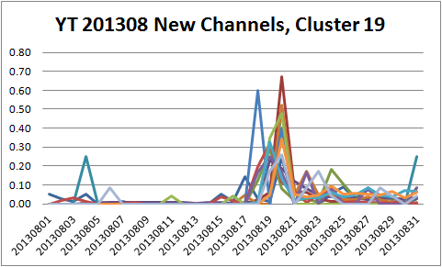
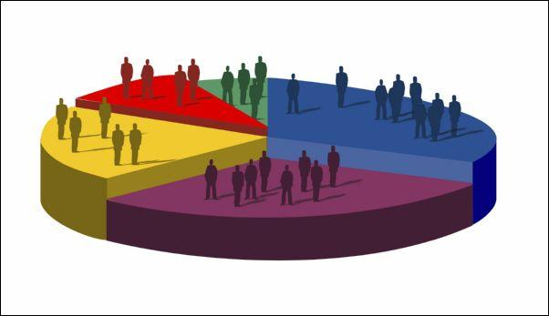
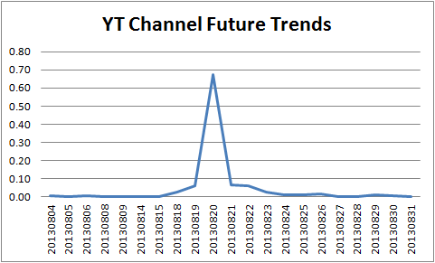
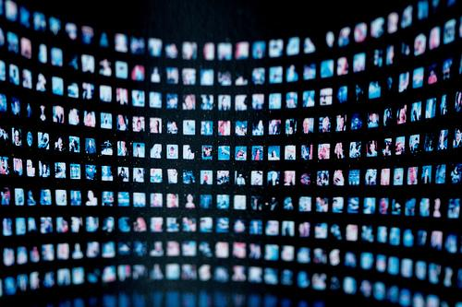
Do specific audiences consume videos in specific ways?
Can we use existing channel data to characterize a new channel’s impression trends?
How can we identify similar channels using audience demographics?

Slide 3
Characterizing new channel impression trends
Categorizing trends and matching new channels to those trends

Slide 4
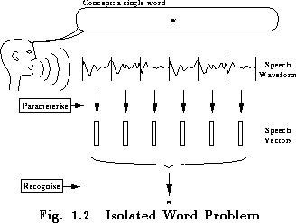
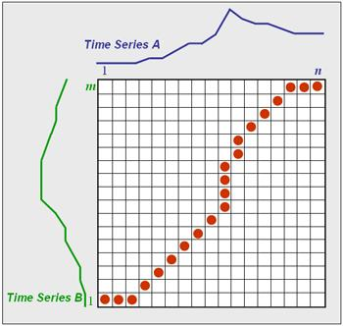
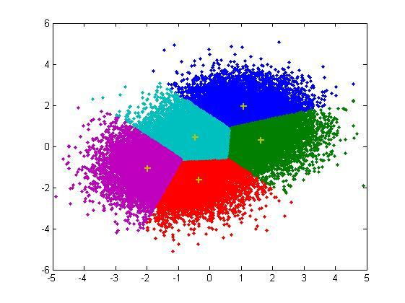
Approach (Part 1/2)
Categorizing trends
Hidden Markov Model (hard to define discrete states)
Dynamic Time Warping (duration between inflection points matter)
k-means (okay since starting from zero, set time window)

Slide 5
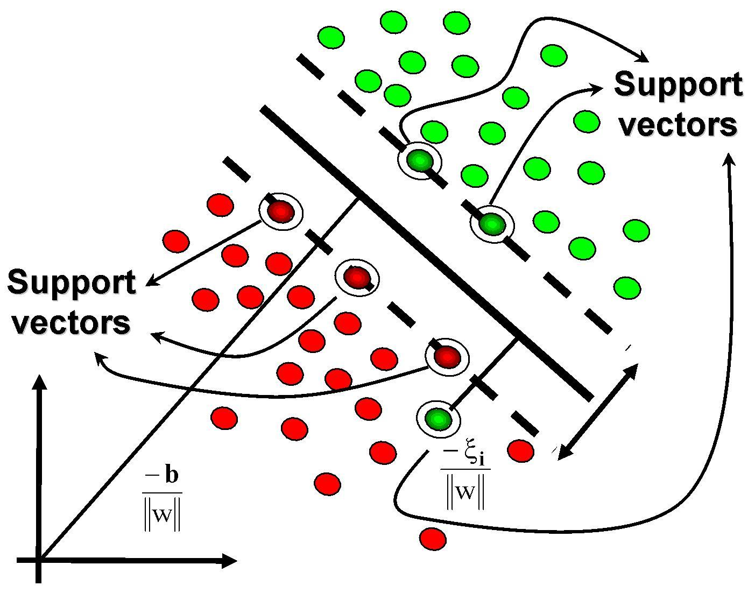
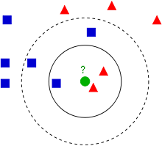
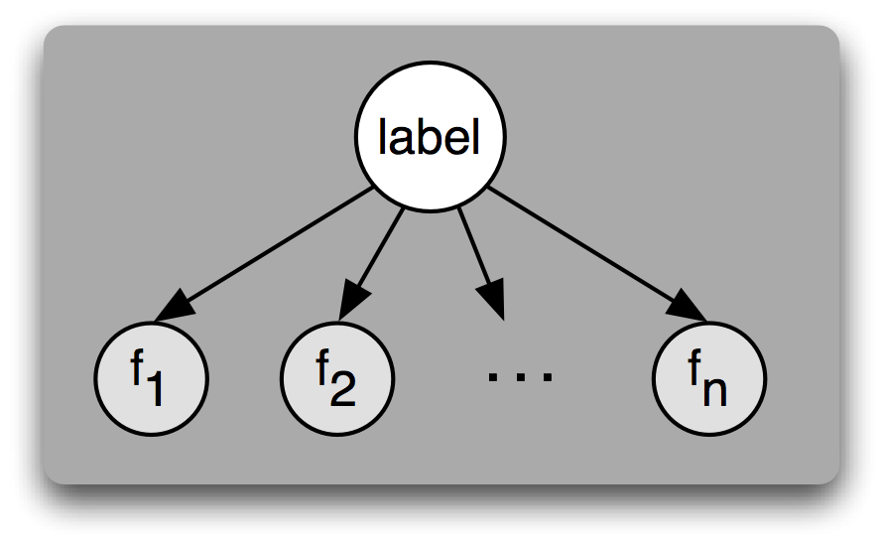
Approach (Part 2/2)
Matching a channel to a trend
SVM (not binary)
Naive Bayes (data’s high variance/low bias - tried it, horrible)
kNN (all the features are numeric and normalized)

Slide 6
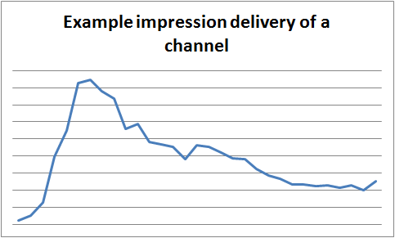
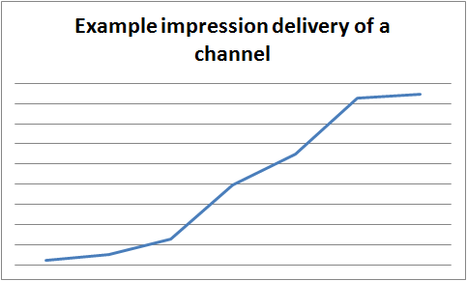
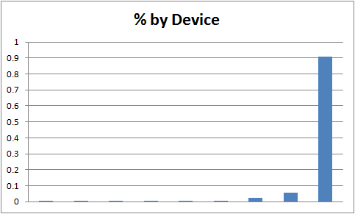
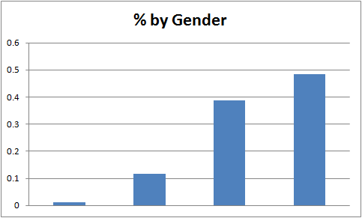
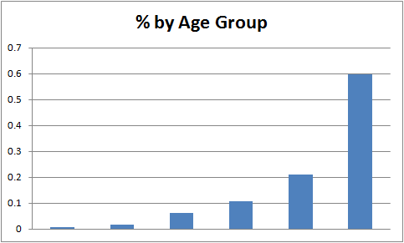
Data *aggregated/hidden
Trend data for new channels, not mature ones
One country
Recent
Demographic data for each channel
Gender (% m/f/o/blank)
Age range (% for each age range)
Device (% for each device type)

Slide 7
Trend Data
Issues
Late upload date*
Discontinued channel (e.g. copyright material)
Unpopular video with few/no impressions*
Varying channel age
Different countries blocked content
Massaging the data
Normalize impressions (impressions range from [0,1], sum to 1)
Just the US
30 day window for all channels created 20130801 (feature for each date)
Keep only channels that had impressions on last day

Slide 8
Demographic Data
Age range (7 features)
6 buckets + 1 blank bucket
Gender (4 features)
male, female, other, blank
Device (10 features)
web, mobile, tv, etc.

Slide 9
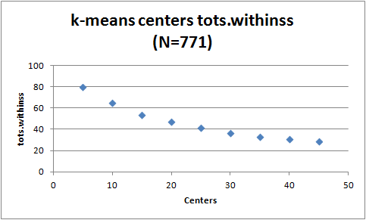
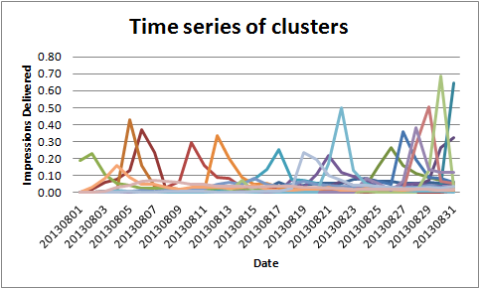
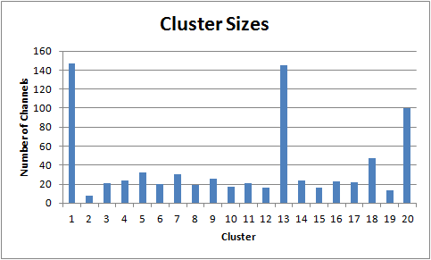
Clustering Trend Data
R k-means (re-used homework functions!)
Centers = 20 (close to rule of thumb sqrt(N/2))
Channel distribution in clusters appears skewed to clusters 1, 13, 20

Slide 10
Demographics Data
Normalization
Distribution gathered over 201308
Naturally weighted towards larger feature sets (device=1/10, ages=1/7, gender=1/4)
Emphasize age and gender over device
Features
Device
Age
Gender
Weight

Slide 11
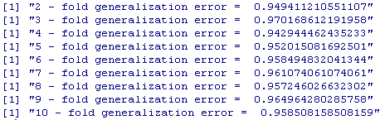
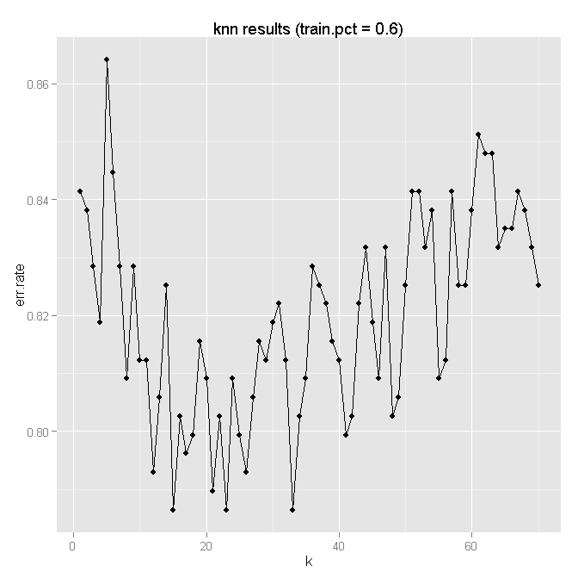
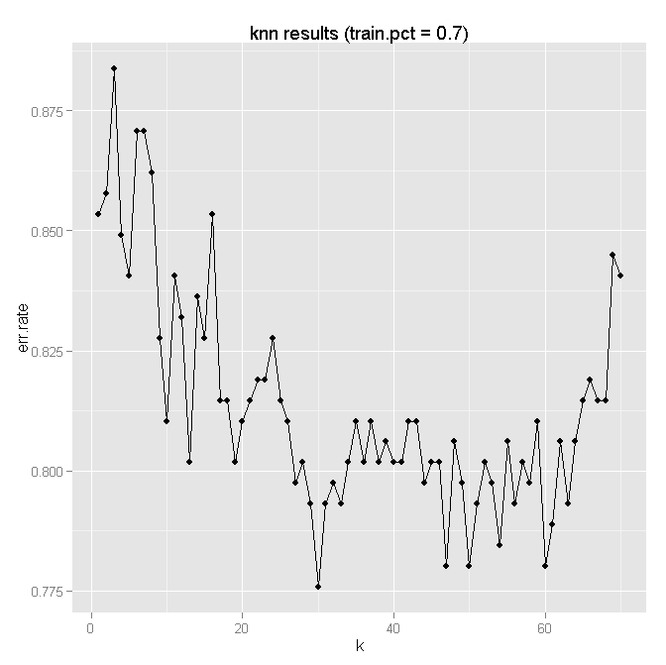
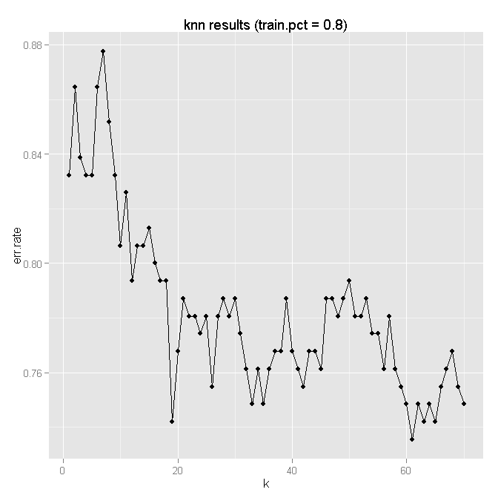
Classify Demographics to Labels?
Naive Bayes
Terrible (GE ~95%)
kNN
Less terrible (GE ~76%)

Slide 12
What went wrong?
Trend data
Users upload files inconsistently
If users upload regularly, HMM is better
Seasonality (day of week, day of year)
Additional data (only 771 channels is tiny)
Longer time horizon
Measure the magnitude
Demographic data to trends
More sophisticated classifier (Random Forest, etc)
Additional features (i.e. specific ages, language, etc)
Adjust normalizations/weightings

Slide 13
Identifying similar channels using audience demographics
Kind of like a recommendation system

Slide 14
Approach and Data
Using the same demographic data, run k-means clustering
Same sqrt(N/2) rule of thumb used for centers
Same weightings (1/10, 1/7, 1/4)
Run it multiple times (nstart) to get a consistent convergence

Slide 15
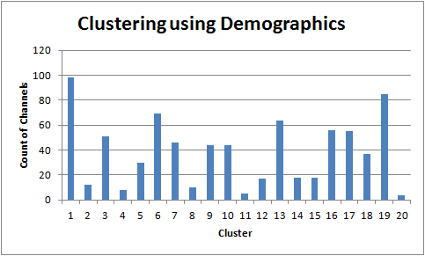
Like TV stations with shows
Clusters ended up being pretty consistent from demographics alone
Stations for
Beauty and fitness (young women)
Military, planes, cars (young men)
Documentaries, news (old people/daytime TV)
Education and family (kids/parents)
Video games (young boys)
Teen beauty (teen girls)
…
Nuances within similar videos
Fitness (men/women)
Beauty (teen/women/general)

Slide 16
Making it better
Include text metadata
Title
Description
Comments* (probably very noisy)
More granular ages (rather than age buckets)
Add language

Slide 17
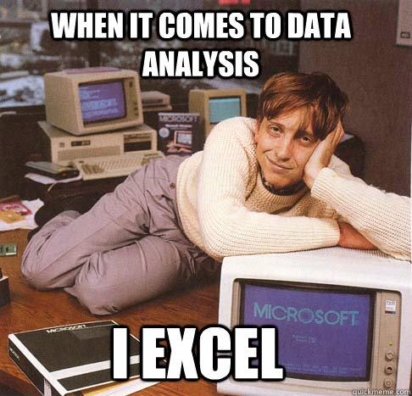
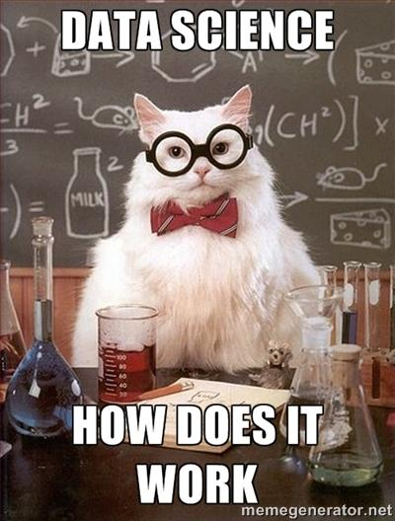
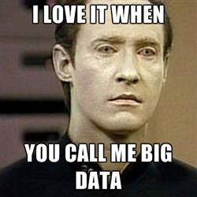
Questions + Suggestions

